Slide 1

Term Project
Telco Customer Churn Prediction

Slide 2

Overview of Project
Goals and Objectives
To build a predictive model to predict the customer churn rate based on the given attributes in the data set.
To find the attributes that positively and negatively affect churn rate and provide recommendation to retain the customers.

Slide 3
Business Understanding
Industry Analysis
Porter’s Five Force Analysis
Threats of new entrants
Telecommunication is one of the most capital intensive industry. So an entrant’s biggest challenge would be the capital investment which is really high and also the recurring financial needs for investing in land, facilities, infrastructure and major manufacturing equipments. The other barrier would be that there are already lot of well established companies who have achieved almost everything, a new entrant is expected to have some innovative technology or which the other companies doesn’t have or same plans with reduced prices(which will again reduce the profit) to make the customers switch to their service. So due to strong barriers in this industry the threat of new entrants is minimal.
Power of suppliers
Some of the suppliers for telecom industry are the equipment manufacturers, switchboard equipment manufacturer, fiber optic cables manufacturer, network equipment manufacturer. There are wide range of manufacturers for this particular industry ranging from Cisco, Tellabs Nokia, Motorola and many more. As there are large number of suppliers, companies have lot of options to choose from so they naturally lose their bargaining power and give the control to the telecom companies

Slide 4
Threat of buyers
As there are large number of well established companies within the industry like AT&T, T mobiles and many more, the bargaining power of the customers is raising. If a company introduces a innovative technology or gives out an eye grabbing offer, there is a good chance that the customer is going to switch to that service as the switching cost is also not that high.
Threat of substitutes
There are number of substitutes like Internet Telephony(calls are made over the internet), emails, instant messaging can pose a threat to the tele- communication industry. Internet telephony poses are major threat to the telecom industry, as more often than not there is no cost associated with it, also with applications like skype and facetime, the Internet telephony has become a major threat to the tele-communication industry. And some cable televisions are also providing tele communication services along with cable services, which also imposes a major threat.
Competitive rivalry
The telecommunication industry has reached a saturation, when it comes to voice calls. As almost everyone has a voice call service with one telecom company or the other, the companies in the industry can only try to poach customers from their business rivalries. This increases competition in the industry as each company is trying to come up with different kind of technologies or offers, to lure the customers from its competitors.

Slide 5

Firm and Description
Incorporated on October 5, 1983
Headquartered in Dallas, Texas
Is one of the world leader in communications and technology, and engaged with media and entertainment.
Ranks 7th in directory of brand Finance. It has a brand value of $59.904 billion
In telecom industry it ranks 2nd in the world
Has a market share of 34% in the US
Provides communications and digital entertainment services in the United States, Mexico, Latin America and the world.
Has recorded 35 consecutive years of quarterly dividend growth and is a Fortune 10 company.
The Company operates through four segments: Business Solutions, Entertainment Group, Consumer Mobility and International
The Company offers its services and products to consumers in the United States, Mexico and Latin America and to businesses and other providers of telecommunications services worldwide
American Telephone & Telegraph

Slide 6
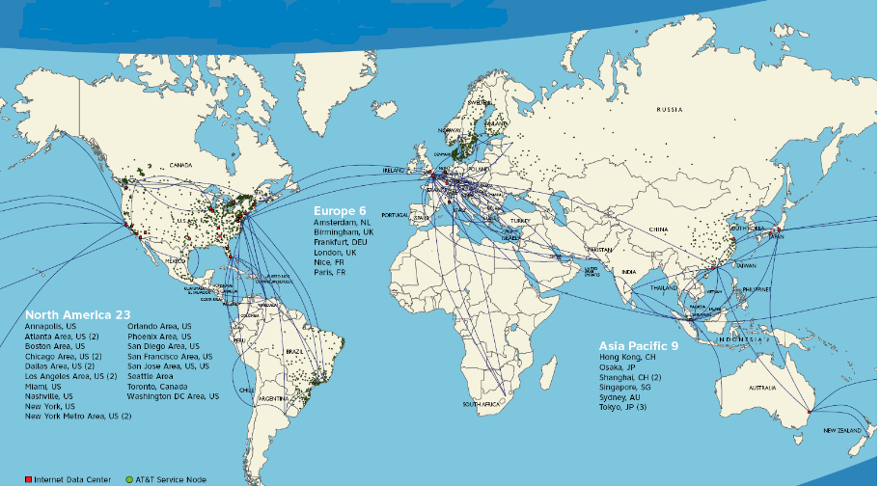
Geographic footprint
United States
United Kingdom
Australia
France
Germany
Italy
Israel
Mexico
China
Dominical REPUBLIC
Canada
Philippines
India
Jamaica
Canada
Brazil
Hongkong
Singapore
japan

Slide 7
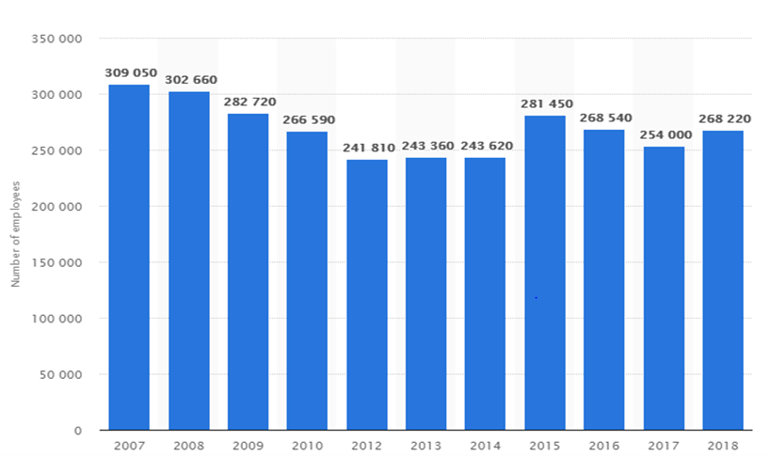
No. of Employees 2018– 268,220

Slide 8
Firm’s(AT&T) 4 Distinct Business Units
AT&T Communications
WarnerMedia
AT&T Latin America
Xandr

Slide 9
Targeted Business Unit and its service line
AT&T Communication
provide services to U.S based consumers
,
Strategic services
Internet services/cloud services
Voice and Data/broadband
Video services
Wireless communication
Telecommunication equipment
Streaming services – DIRECTTV, Fiber, Cricket Wireless, U Verse TV

Slide 10
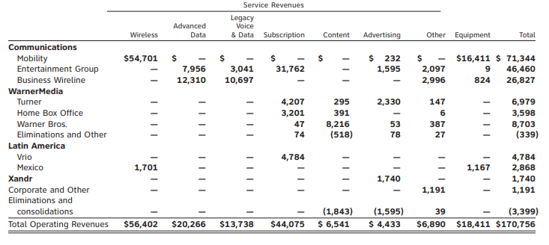
Services Revenues

Slide 11
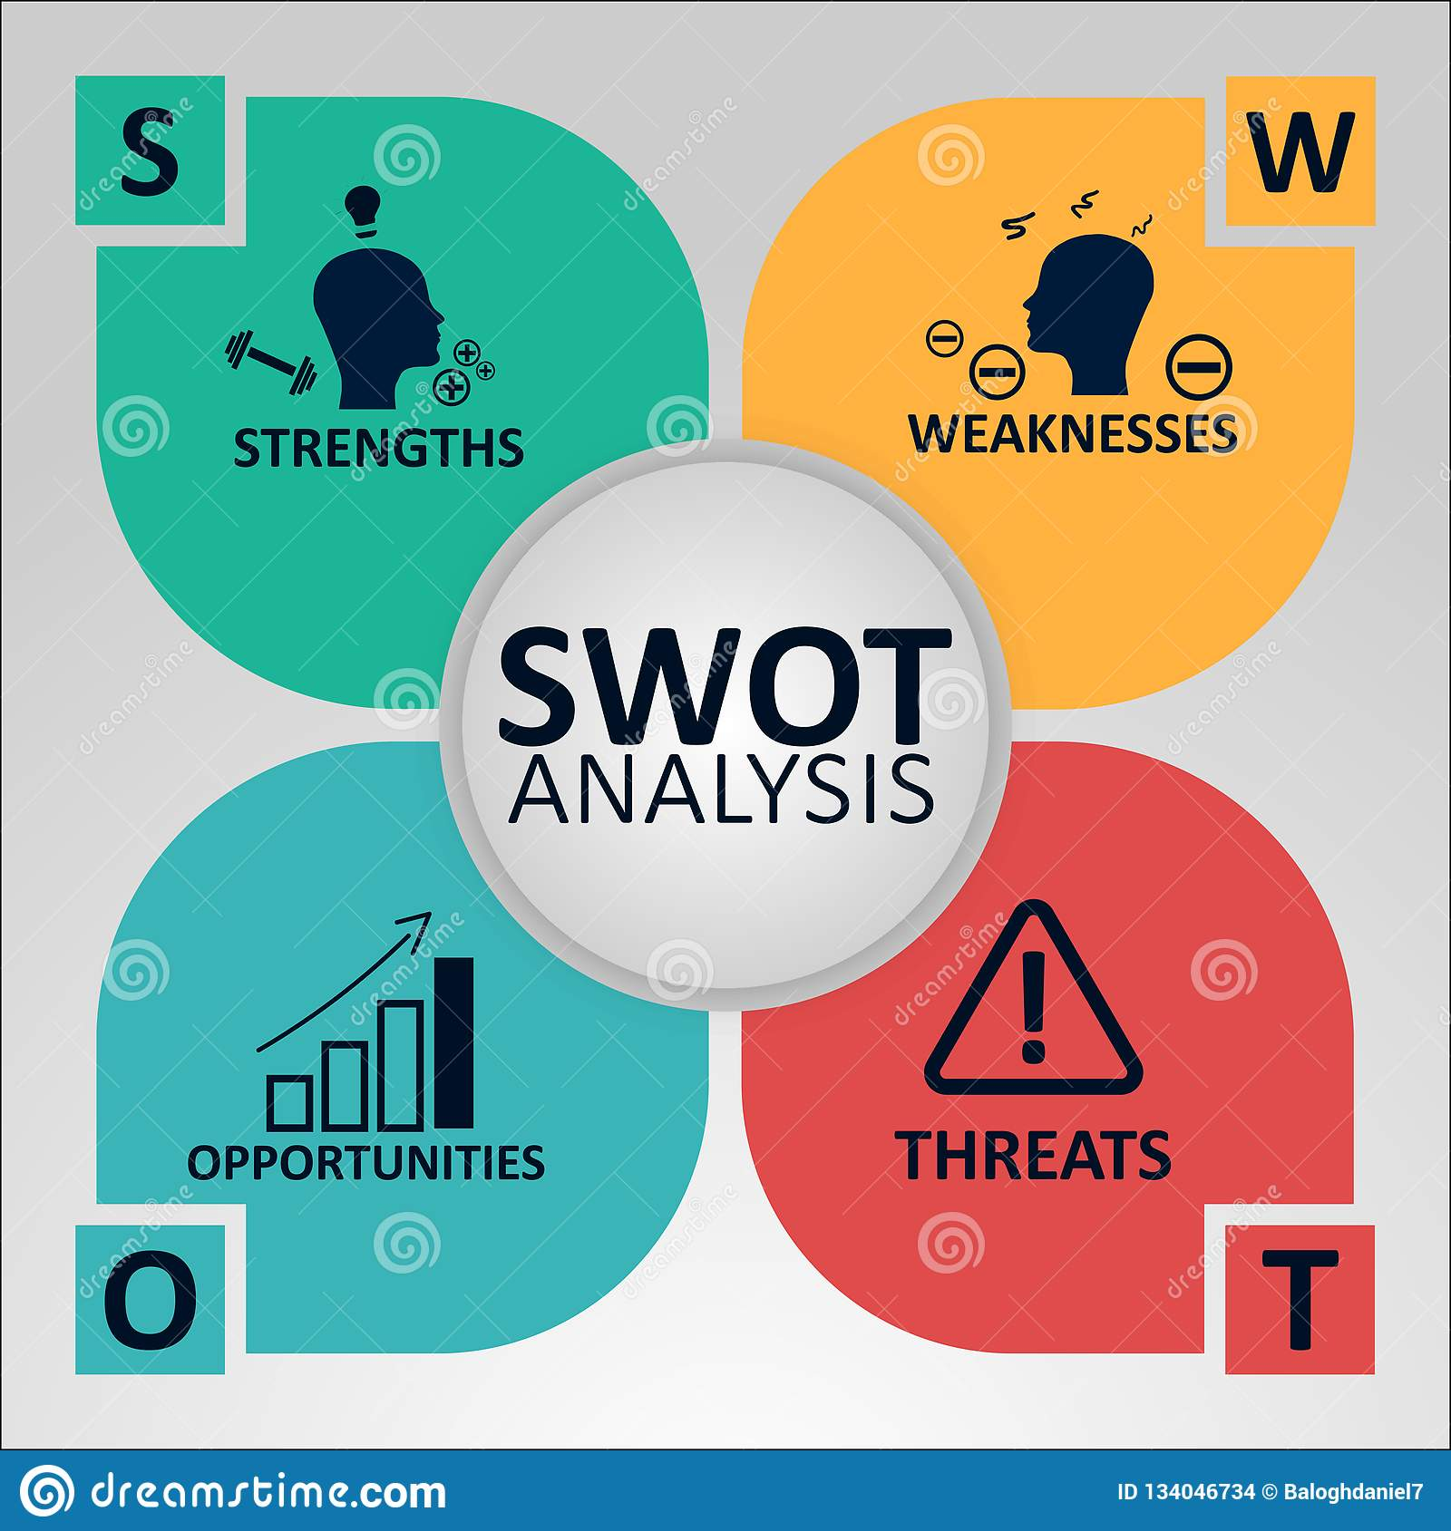
SWOT Analysis(AT&T)
Strengths Brand value(ranks 7th in directory of brand Finance) Telecom industry Ranking(2nd in world) Diverse Business Portfolio Wireless alternate use(ethernet/VPN) Infrastructure | Weaknesses Huge Falls in Financials(AT&T had registered a loss of $11.746 billion) Decline Voice calls(As opted for video calling)
Opportunities Increased focus on Cloud computing High Bandwidth for mobile subscribers Acquisition(Direct TV/Nextel Mexico) Improve Mobile broadband Capability | Threats Saturation Competition(Verizon/Sprint/T-Mobile) Laws and Regulations(International Operations – high irregularity in law and regulation)

Slide 12

Business Understanding
Industry
Wireless and Telecommunication
Firm Name
AT&T

Slide 13
Data Analysis and Understanding
Data Description:
Each row represents a customer
Number of records: 7043 rows and 21 columns
Period of time: One month data and collected on 13th April 2015
Target variable: The Churn column is our target variable
Link of dataset
Each column contains customer’s attributes described on the column Metadata.

Slide 14
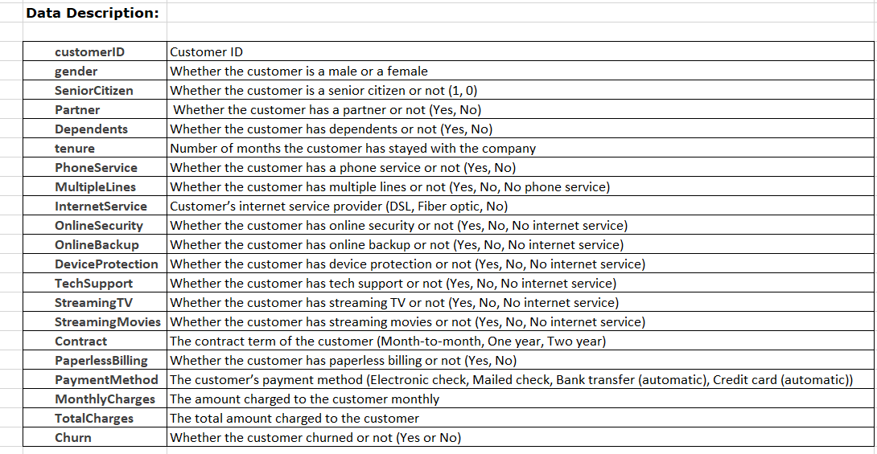
Data Description

Slide 15
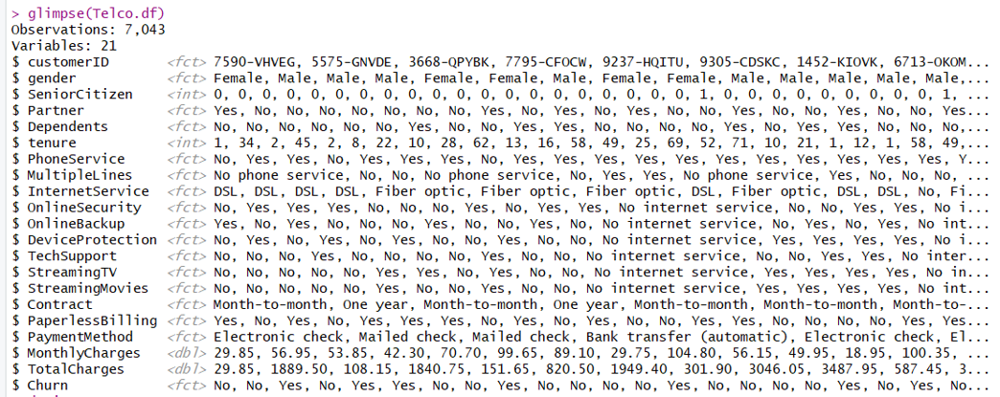
Data glimpse in R-Studio

Slide 16
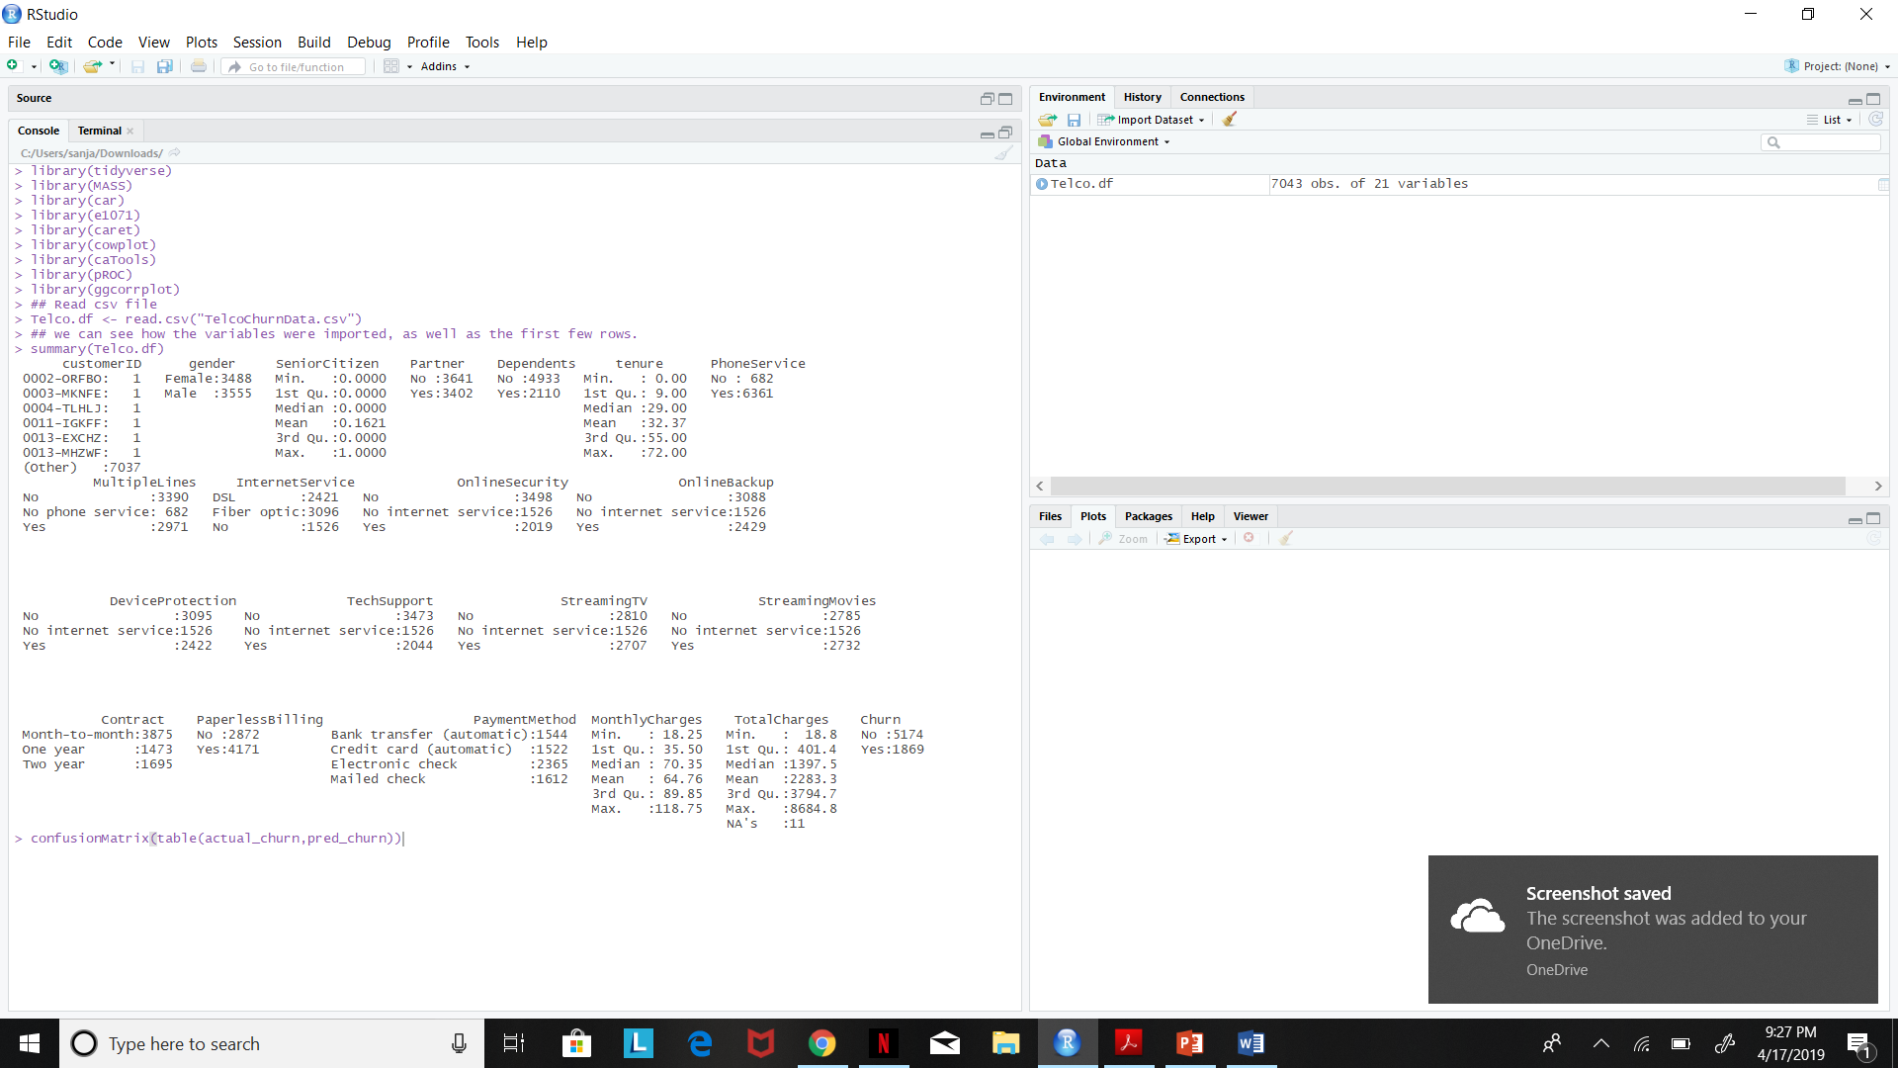
Descriptive Summary Statistics

Slide 17
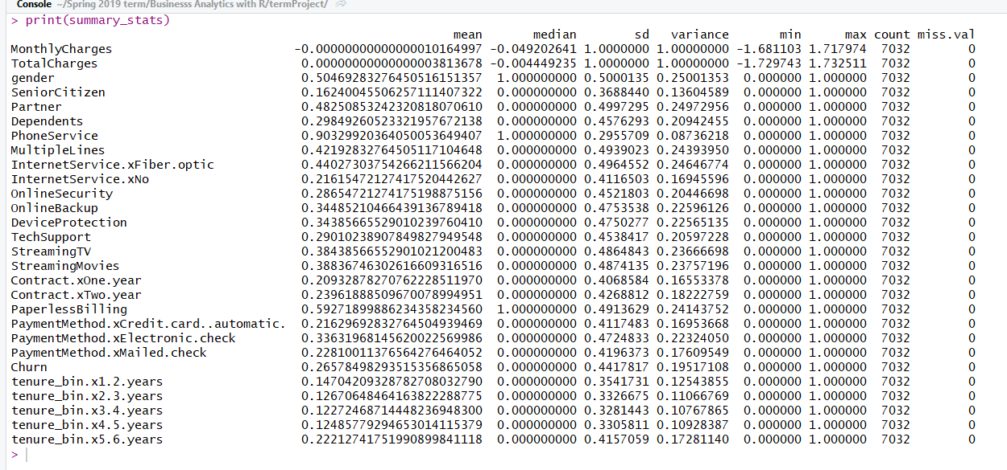

Slide 18

Visualizing statistics

Slide 19
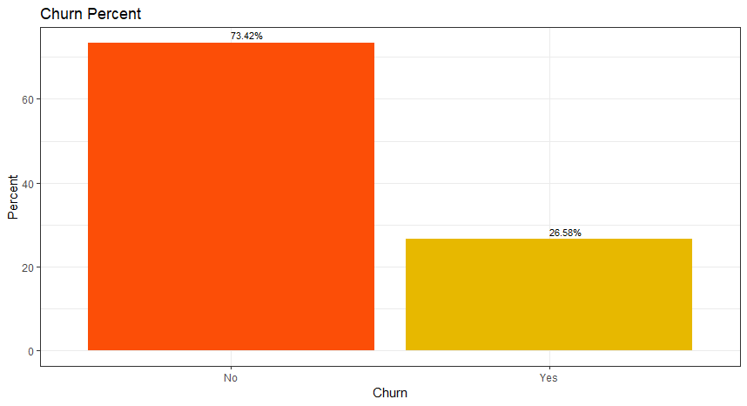
Churn Percent
Observation:
Churn columns tells us about the number of customers who left within last month is around 26%.

Slide 20
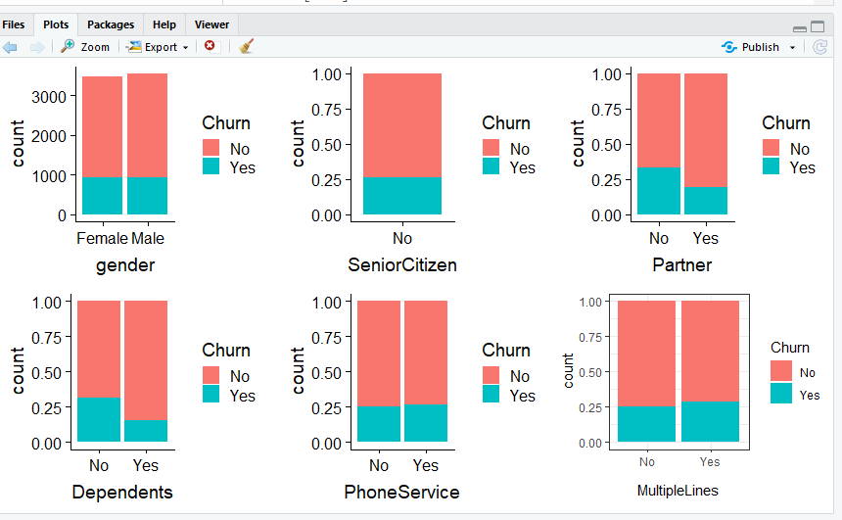
Bar Plots for the independent (categorical) variables
Observation:
Gender- The churn percent is equal in both male and female
The churn rate is higher in senior citizens
Customers with a partner has a lesser churn percent
Customers with a dependent has a lesser churn percent
Customers with and without Phone service have almost same churn percent
The customer with or without multiple lines again have same churn percent

Slide 21
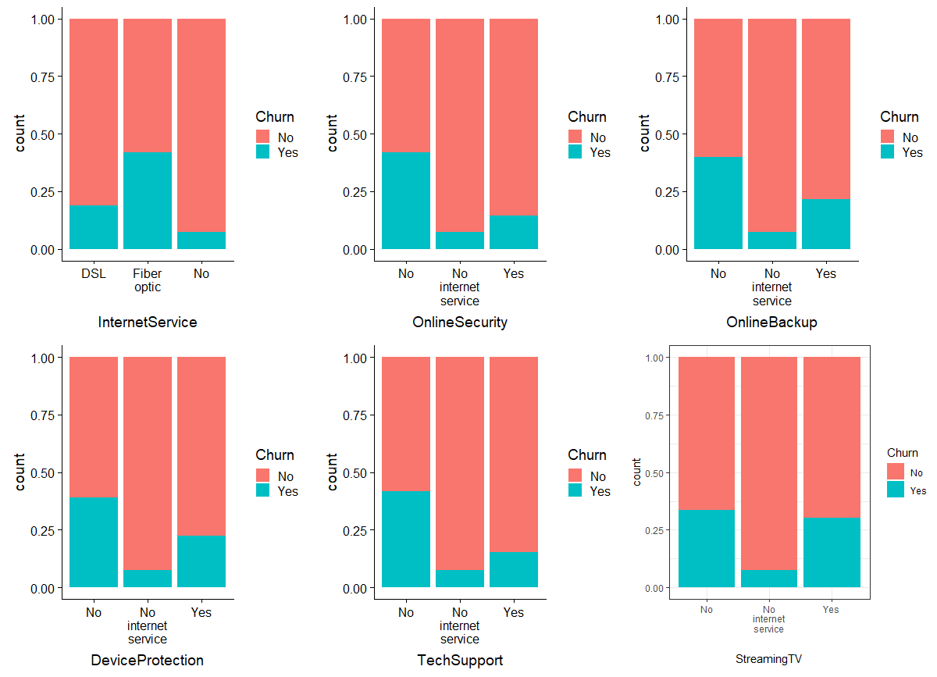
Bar Plots for the independent (categorical) variables
Observation:
Churn rate is much higher in case of Fiber Optic InternetServices.
Customers who do not have services like No OnlineSecurity , OnlineBackup and TechSupport have left the platform in the past month.

Slide 22
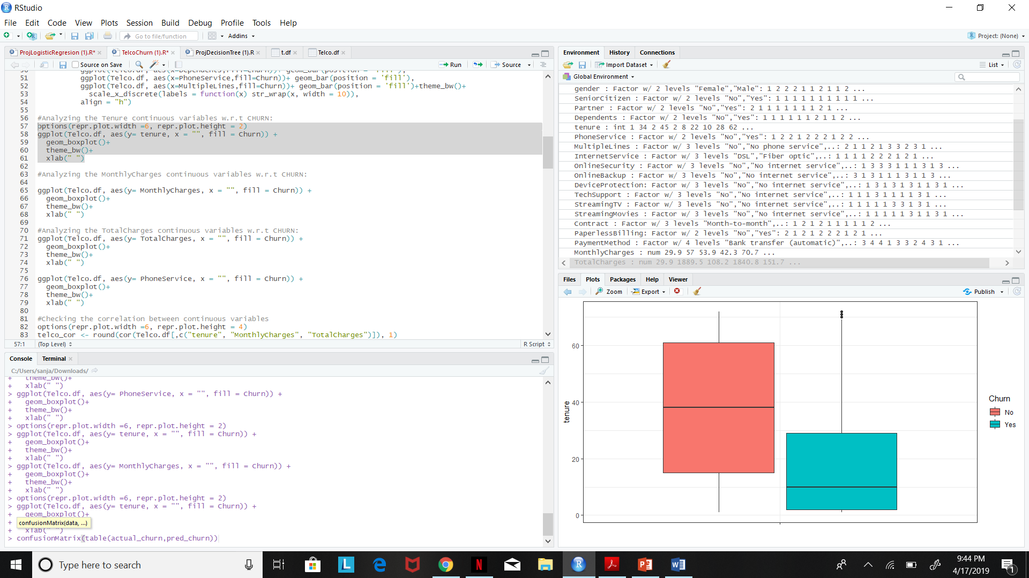
Box Plot for Independent( Continuous) Variable Tenure w.r.t Churn
Observation:
The median tenure for the customers who have churned is approximately 10 months.
It can be observed that the customers whose tenure ranges from 10 months to 30 months are more likely to churn compared to the customers who have had a tenure for a longer period

Slide 23
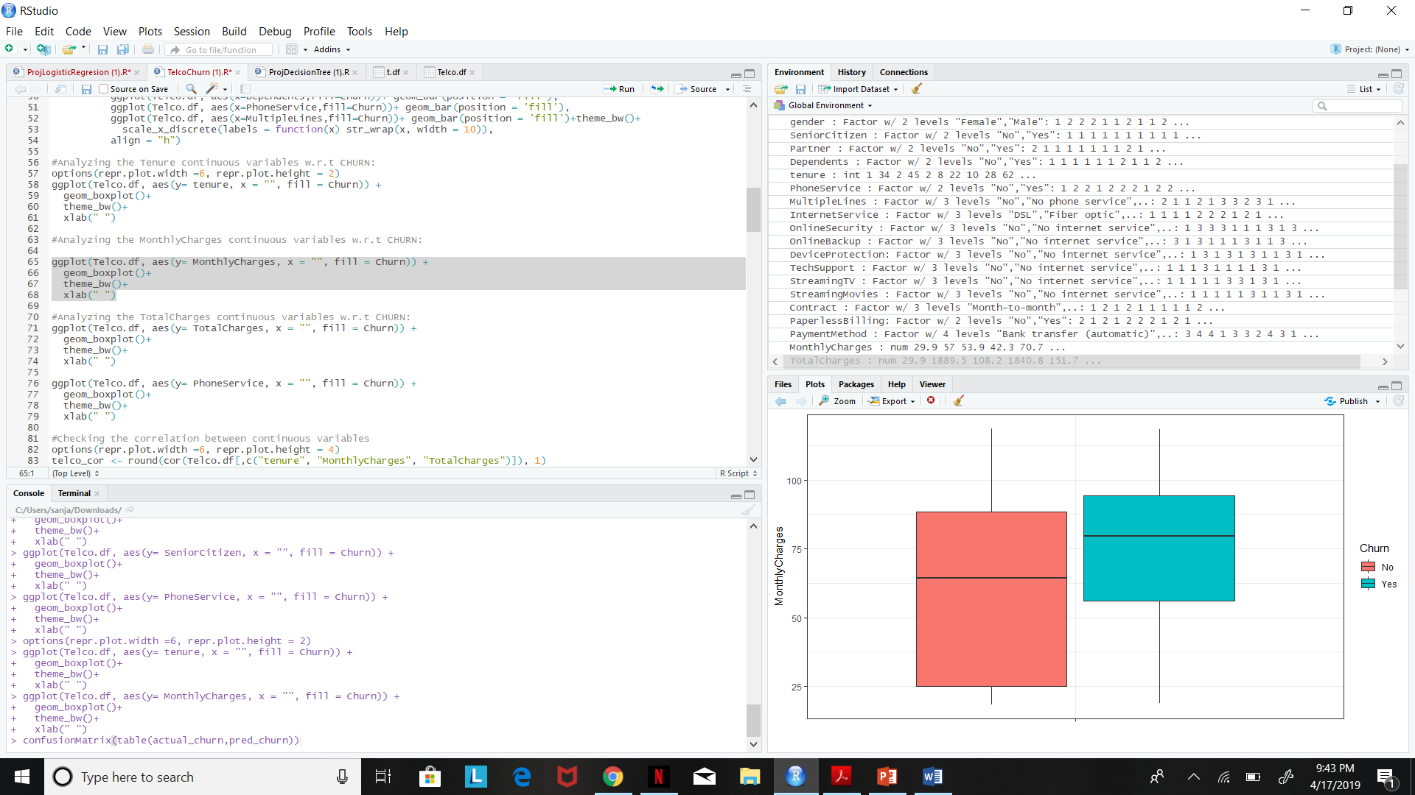
Box Plot for Independent(Continuous) Variable Monthly charges w.r.t Churn
Observation:
The customers who have churned have high monthly charges, ranging from 55$ to 80$, median being around 75$.

Slide 24
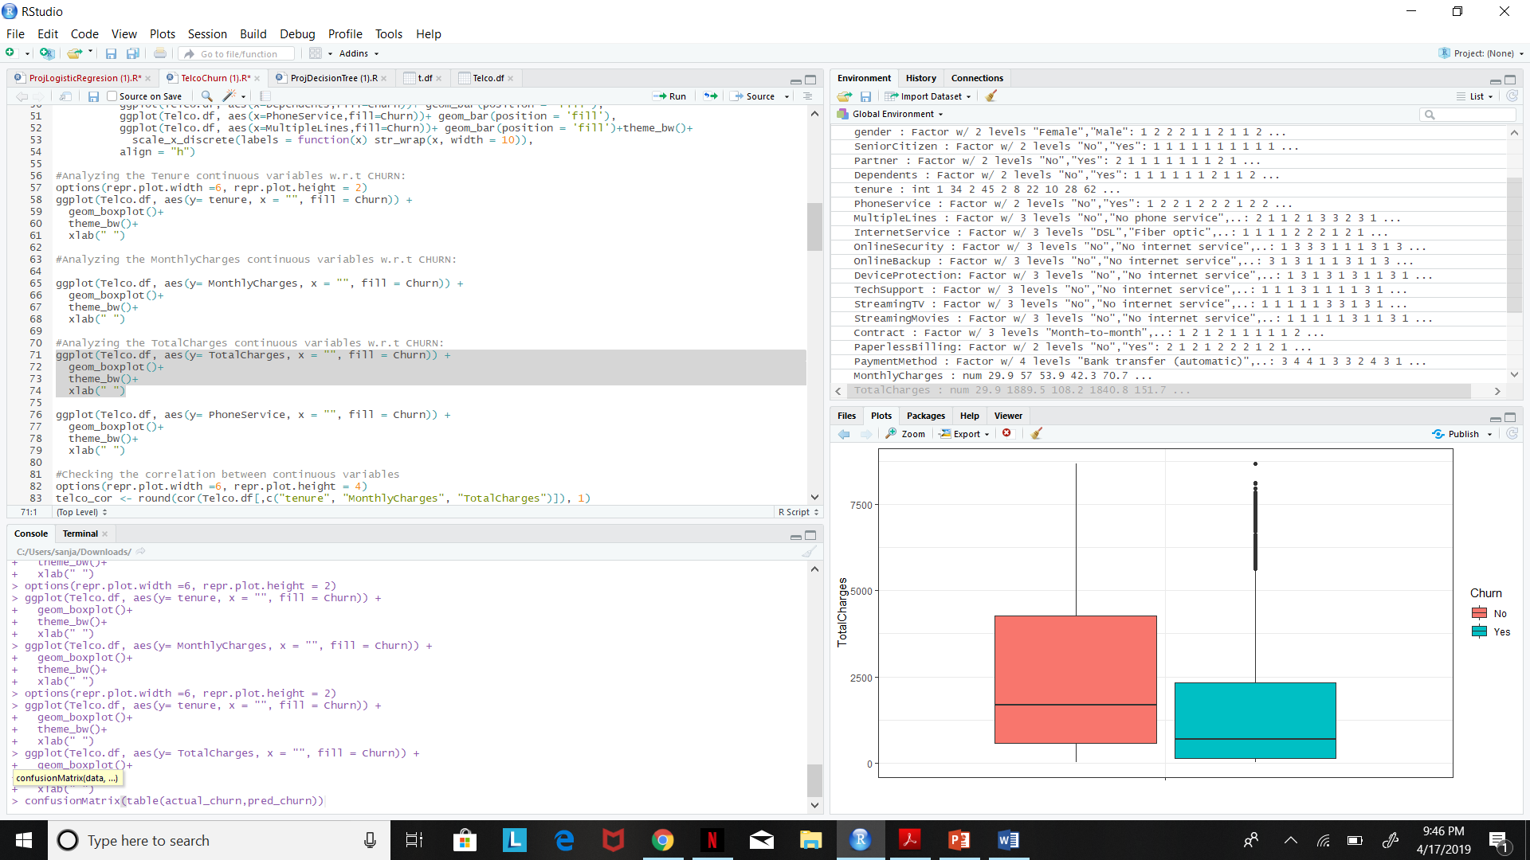
Box Plot for Independent(Continuous)Variable Total charges w.r.t Churn
Observation:
The customers who have churned as a low median Total Charge, when compared to the customers who have not churned.

Slide 25
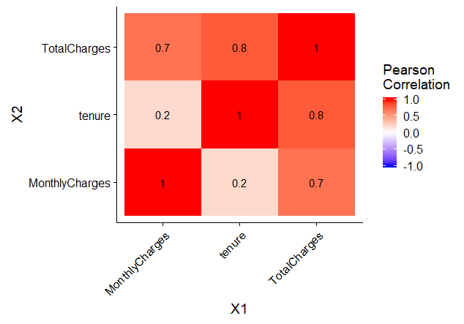
Correlation Matrix between continuous variables
Observation:
Total Charges has positive correlation with MonthlyCharges and tenure.

Slide 26
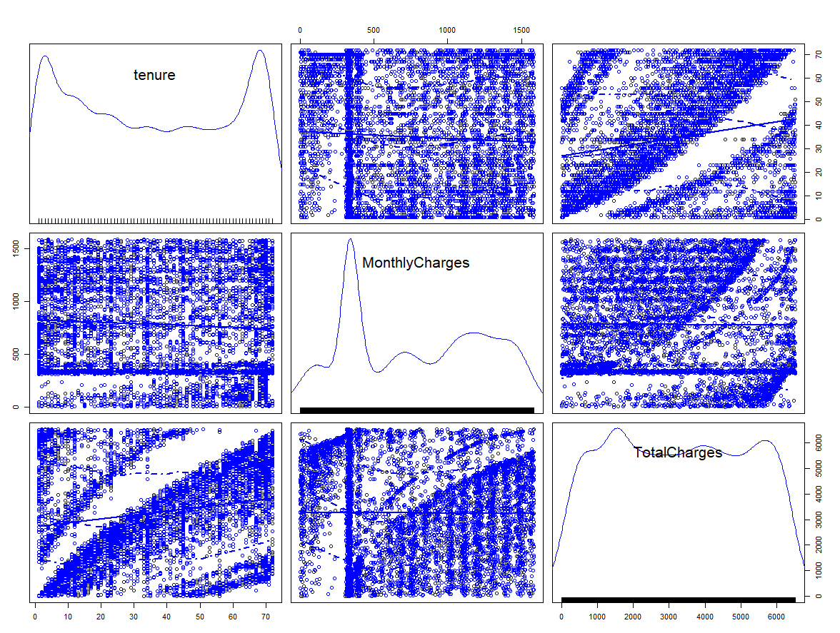
Scatter Plot for Independent(Continuous)Variable

Slide 27
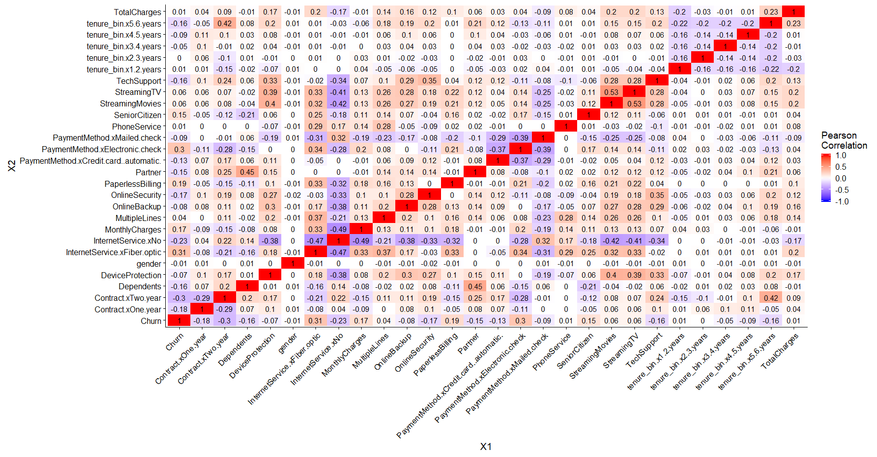
Correlation matrix for variables
Positively corelated
Tenure_bin.x5.6year is with contract Two years
Tech support with contract Two years/Device Protection/Online security/online backup
Streaming TV with streaming movie
Partner with Dependents
Monthly charges with Internet service Fiber optics
Device protection with streaming TV
Churn with Internet service Fiber optics/Payment method electronic check
Negatively corelated
Churn with contract Two years
No internet services with tech support/Streaming TV/Streaming Movie/MonthlyCharges/payment method

Slide 28
The Model
Model – Logistic Regression and Decision Tree
Independent Variable:
Dependent Variable:
Churn
Tenure
Monthly Charges
Senior Citizen
Partner
Internet Service
Online Security
Online Backup
Tech Support
Contract
Paper less Billing
Payment Method

Slide 29
Data Modeling
Goals and Objectives
Target variable: Churn – whether Customers left the services or not
Predicting:
Churn rate
Highlighting the main variables/factors that positively and negatively influencing the customer churn rate
The customers who have the highest chances of leaving.
Use various ML algorithms to build prediction model, evaluate accuracy and performance of these model
Accomplish: Find out the best model and provide recommendations to improve the customer retention program.

Slide 30
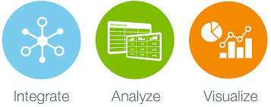
Model Building steps:
Define goal
Data collection
Data cleaning
Feature selection
Build Model
Validate and measure model performance
Improve model performance
Execute model for prediction
Select best model for our business Recommendation
Perform EDA

Slide 31
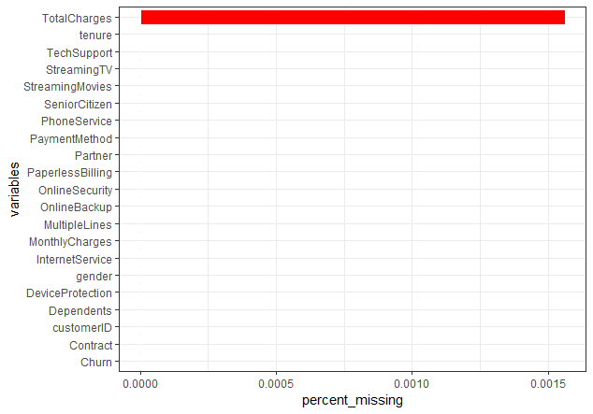
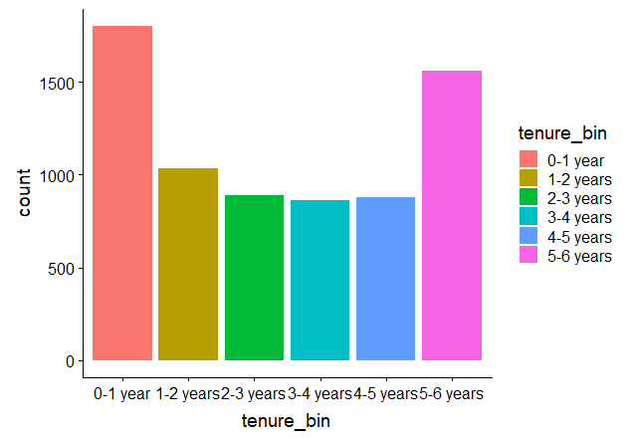
Data Preprocessing
11 missing value in total Charge column
Since the minimum tenure is 1 month and maximum tenure is 72 month, so grouped them into 5 tenures group :“0–12 Month”, “12–24 Month”, “24–48 Months”, “48–60 Month”, “> 60 Month”

Slide 32
For six column “OnlineSecurity”, “OnlineBackup”, “DeviceProtection”, “TechSupport”, “streamingTV”, “streamingMovies” updated column value “No internet service” to “No
For “MutlipleLines” column updated “No phone service” to “No”
For “SeniorCitizen” column updated values from 0 or 1 to “No” or “Yes”
Removed the column we didn’t need for analysis:
CustomerID
Tenure

Slide 33
Models
Logistic Regression Model
Decision Tree

Slide 34
Logistic Regression: In Logistic regression the outcome variable is binary and the purpose of analysis is to assess the effect of multiple explanatory variable.
Step Description
split data into training and validation dataset(70:30)
fit the logistic regression
Build four models
Model 1(considered all training dataset)
Model 2(stepAIC)
Model 3(considered all highly significant variable(p-value) from model 1 )
Model 4 (considered only 3* significant variable (p-value) from model 1 )
Have taken model 4 as it had high accuracy.
Drew the Lift chart and Decile wise chart
Kept threshold limit at 0.5.
probability of customer to be churned> 0.5 -> customer is churned
probability of customer to be churned< 0.5 -> customer is not churned

Slide 35
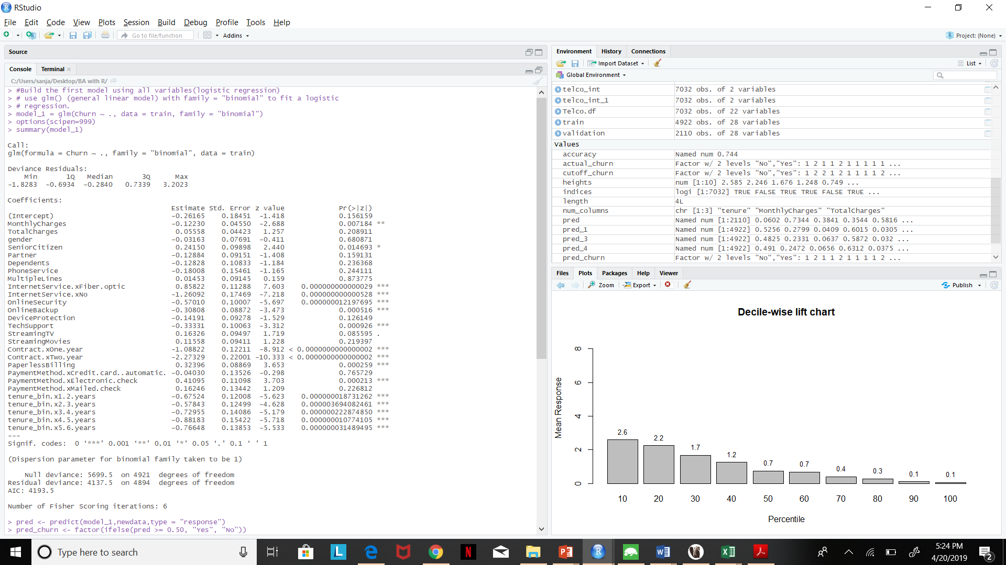
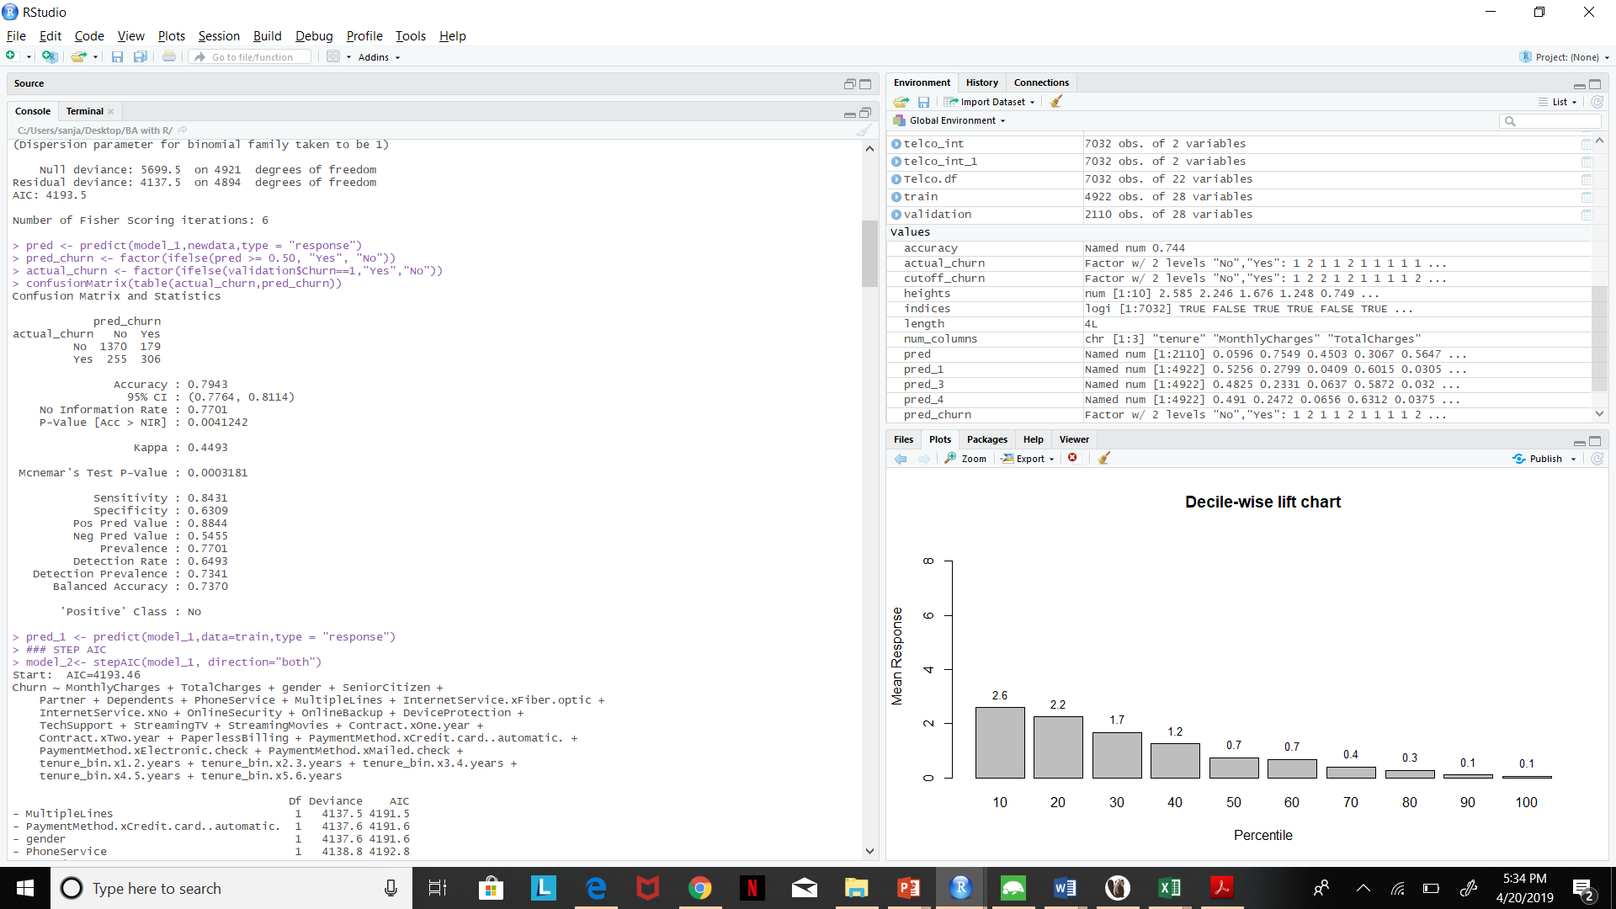
Model 1
For this model we have taken all the variables in the dataset as the predictor or independant variables.
accuracy : 0.7943
This model correctly predicts whether or not the customer will churn 79.43% of the times.

Slide 36
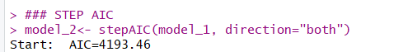
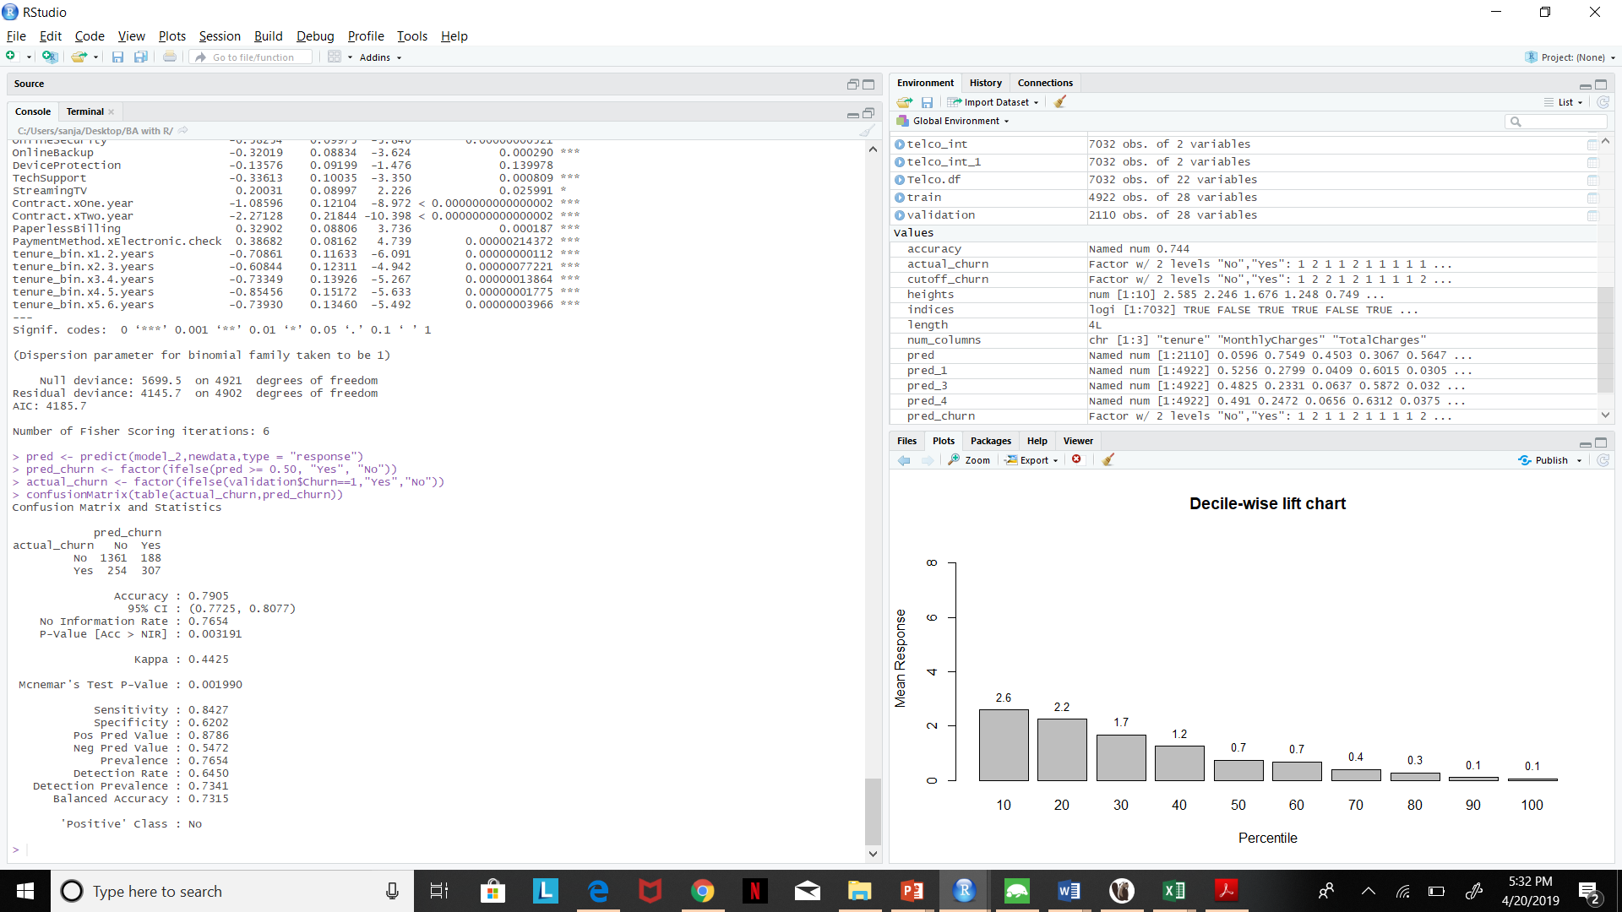
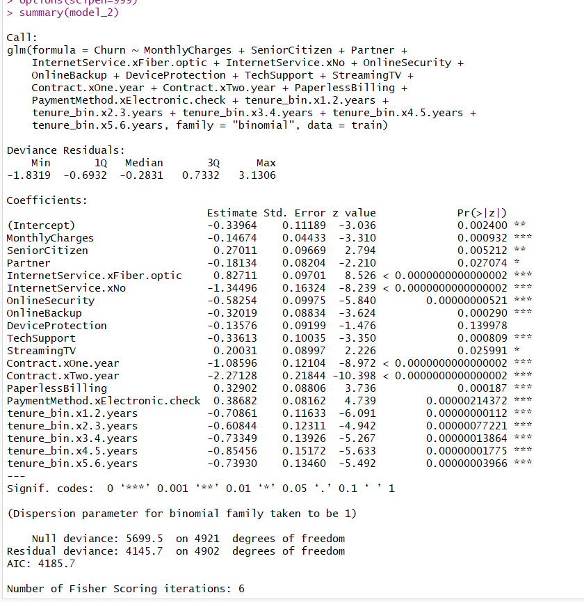
Model 2
For this model we have considered stepAIC, and again we have taken all the variables has the predictor variables.
accuracy : 0.7905
This model correctly predicts whether or not the customer will churn 79.05% of the times.

Slide 37
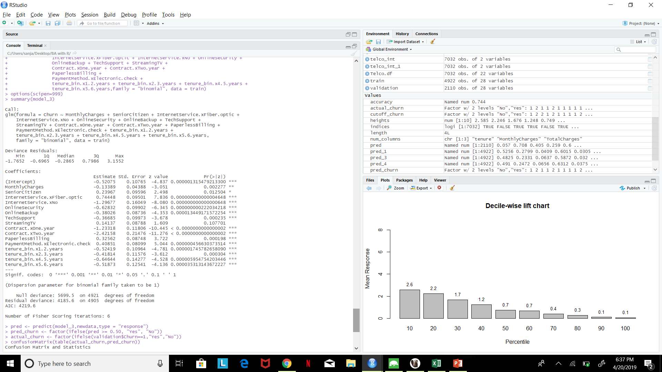
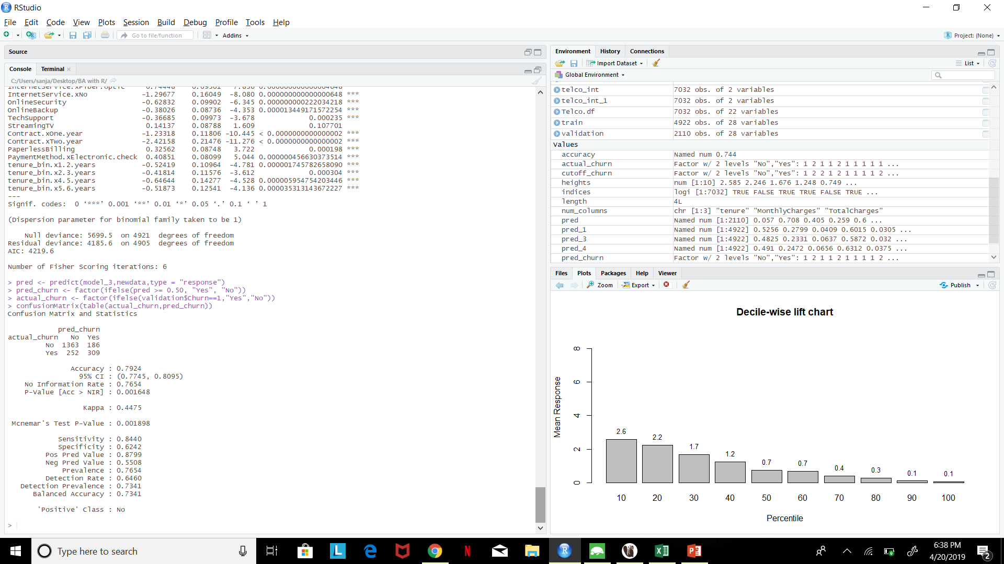
Model 3
For this model, we have considered only the variables that had significance value of 0, 0.001, 0.1 in the first model
accuracy : 0.7924
This model correctly predicts whether or not the customer will churn 79.24% of the times.

Slide 38
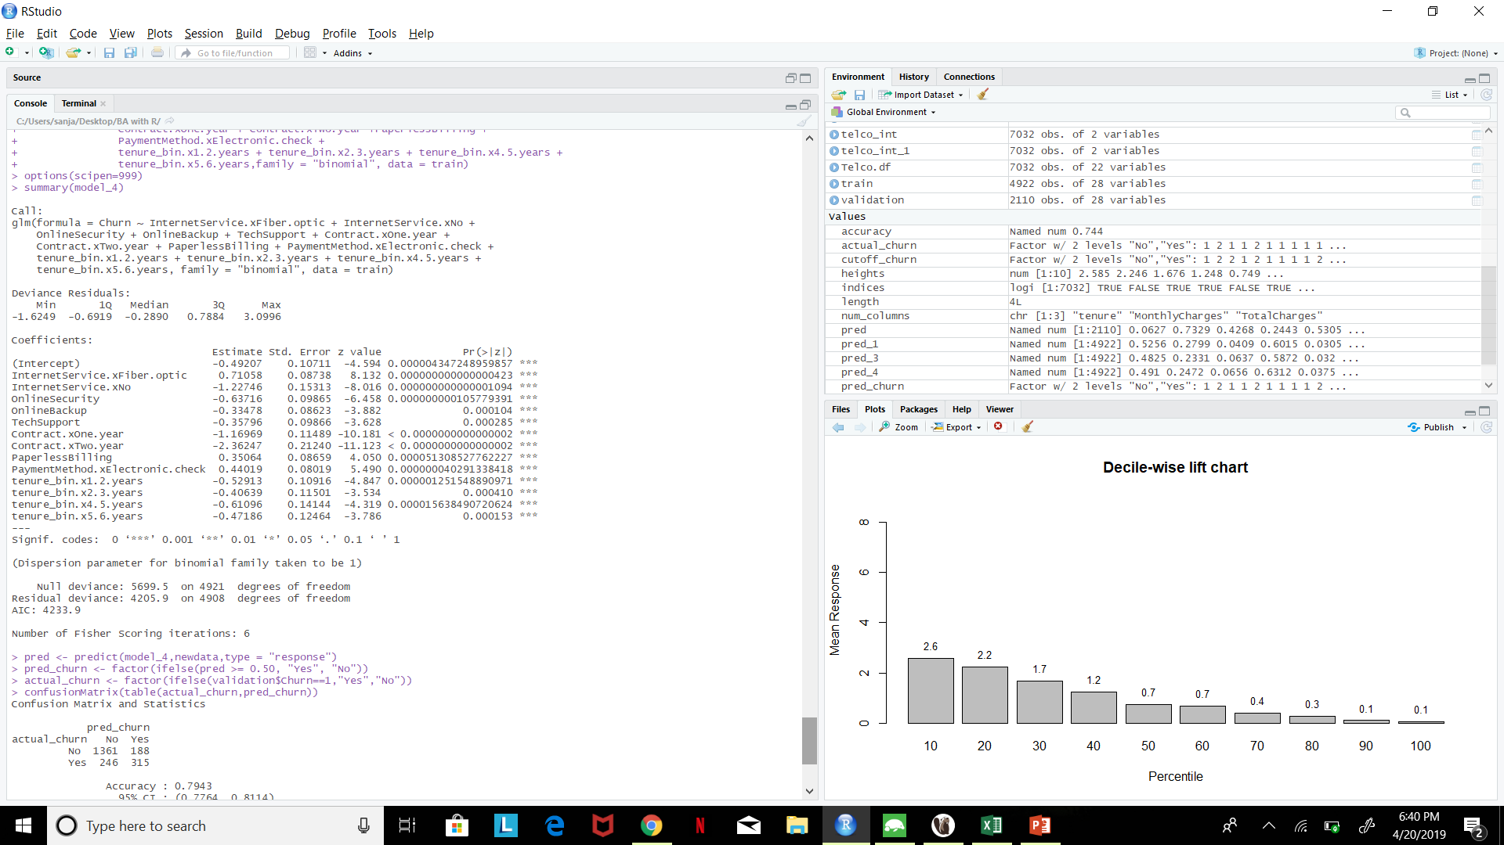

Model 4
For this model, we have considered only the variables that had significance value of 0 in the first model
accuracy : 0.7943
This model correctly predicts whether or not the customer will churn 79.43% of the times.

Slide 39
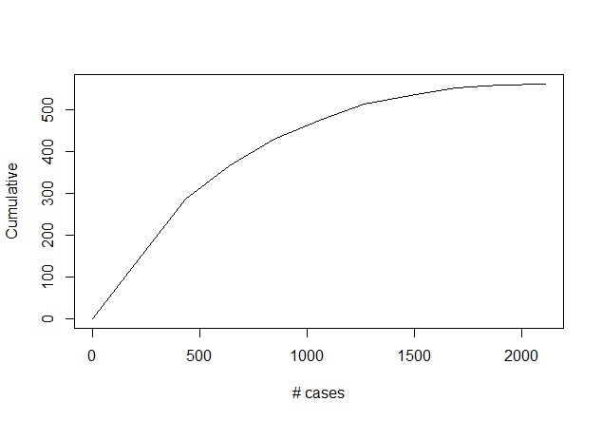
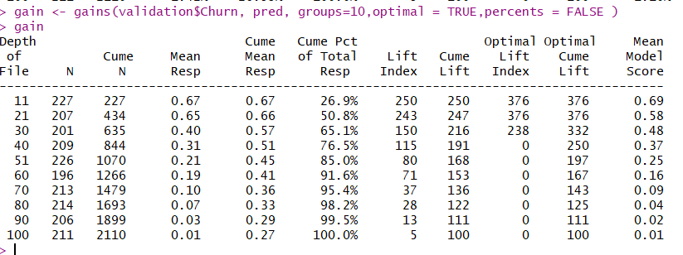
Gain/Lift Chart
Case: probability of responding to churn" score.
Cumulative: cumulative no of cases and sorted by predicted value
lift curve helps us determine how effectively we can skim the cream" by selecting a relatively small number of cases and getting a relatively large portion of the responders.

Slide 40
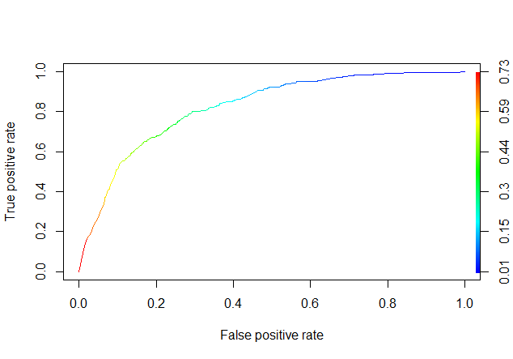
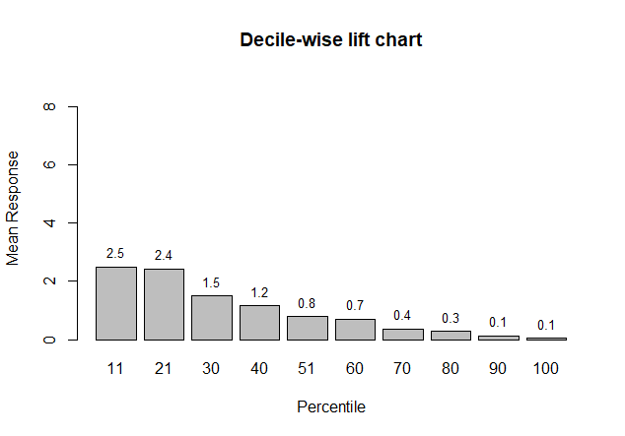
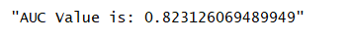
ROC & Decile-wise Lift chart
ROC curve
It summarizes all of the confusion matrices that each threshold produced
Sensitivity:- True Positive rate
1- Specificity:- False Positive rate
Decile- wise Lift chart
The Staircase Effect
model is “binning” your constituents correctly from most likely to respond to least likely to respond

Slide 41
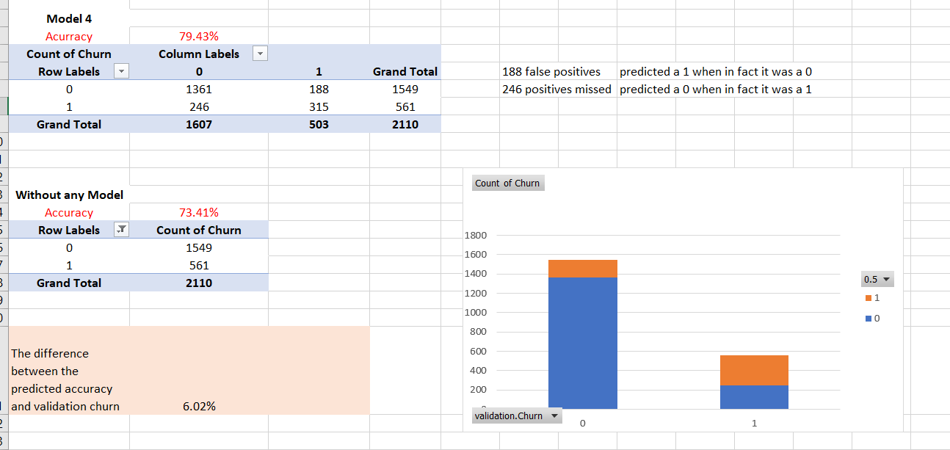
Propensity Table

Slide 42
Decision Tree: The decision tree splits the customer churn dataset into multiple subsets until it arrives at a tree like structure and make a decision. Here the churn acts as a dependent variable and all other variables are used as the predictor variables
Step Description
split data into training and validation dataset
Tree build:
Fully grown(results in overfitting of data)
Pruned tree(optimal data)
Generated if-else business rules

Slide 43
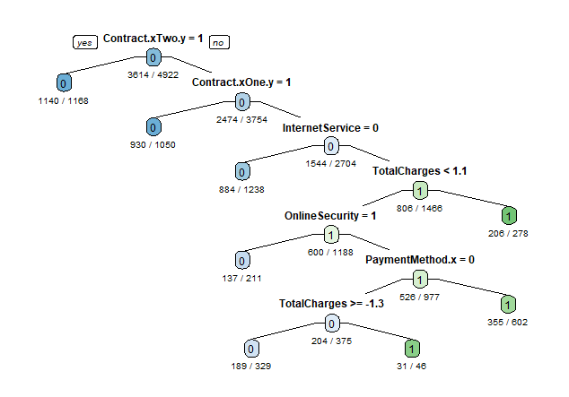
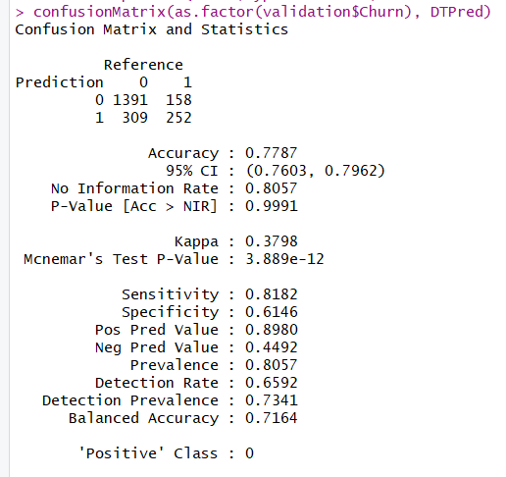
Tree 1 & Confusion matrix
Accuracy: 0.7787

Slide 44
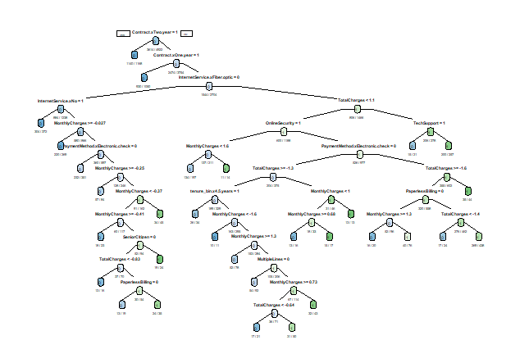
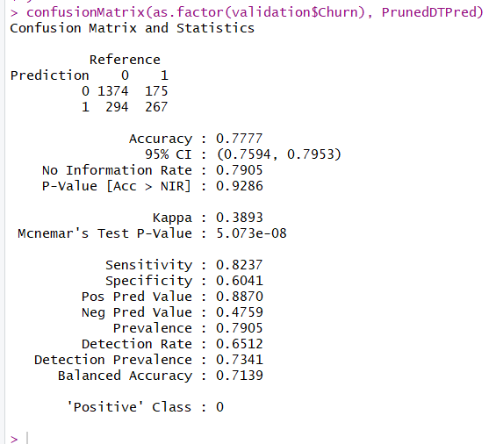
Pruned Tree & Confusion matrix
Accuracy: 0.7777

Slide 45
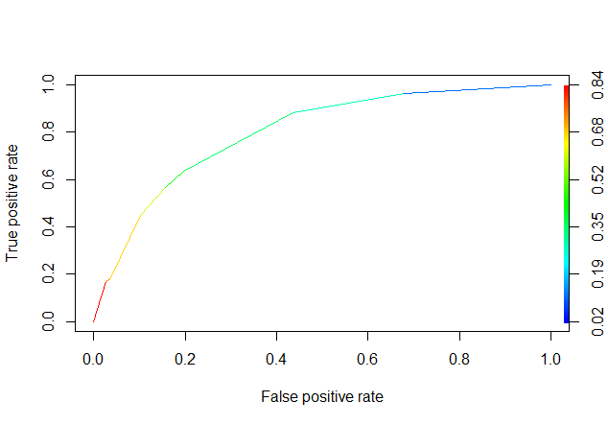
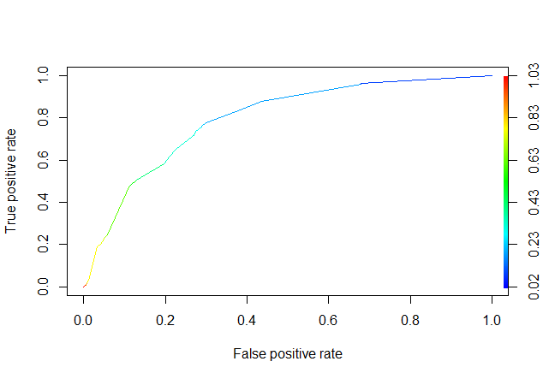
ROC & AUC curve
Tree 1
Pruned tree
"AUC Value is: 0.797590073061915"
"AUC Value is: 0.794071041175435"

Slide 46
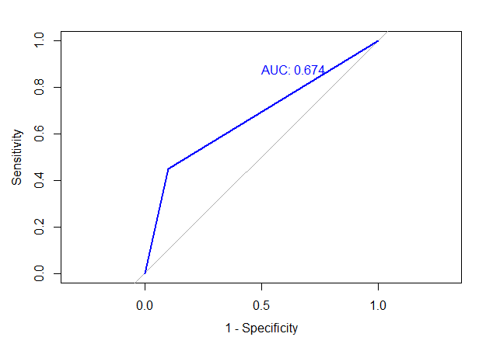
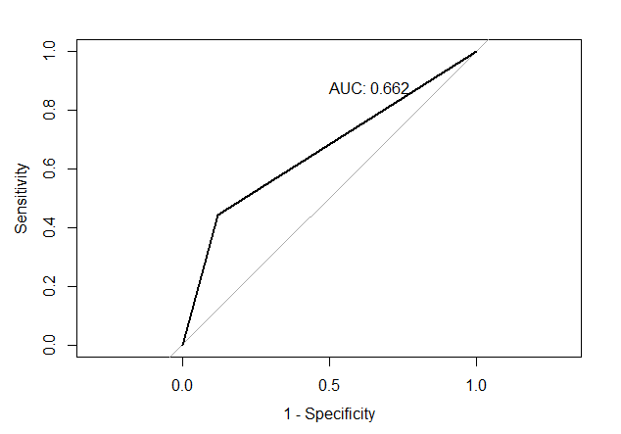
ROC & AUC curve
Tree 1
Pruned tree

Slide 47
ROC & AUC curve
Tree 1
Pruned tree
"AUC Value is: 0.797590073061915"
"AUC Value is: 0.794071041175435"

Slide 48
Limitation of the model
The dataset does not include any unique attribute for the customers. So, if a customer is taking more than one subscription, and churning one of the subscriptions, then the company is forced to believe that the customer has left the company, even though they have other ongoing subscriptions.
The dataset from which the model is formed does not include involuntary reasons for churn (i.e) if a customer churns the service because of reasons like re-location or death.

Slide 49


Recommendation
By analyzing excel data we concluded that contract, internet services, total charges and tenure are the variables which are impacting the churn rate the most. So we can provide AT&T the follow recommendation:
Send emails and provide discounts to customers who are on month-to-month contract if they switch to one year contract or longer term.
Call customer who uses fiber optic internet services and give them better options to switch and suggest company to improve fiber optic services.
Personalize communication to provide better customer services, if still customer is unsatisfied, review and give specialized price plan or bundle deals.

Slide 50
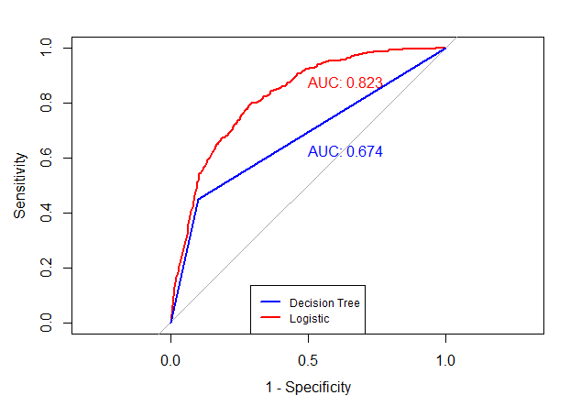
Comparing performance of Logistic and Decision Tree

Slide 51
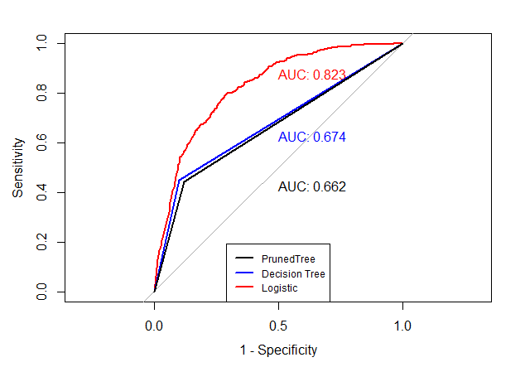

Slide 52
Appendix:
The original, as referred, is from IBM Watson analytics community. Try the follow links:
https://www.ibm.com/communities/analytics/watson-analytics-blog/predictive-insights-in-the-telco-customer-churn-data-set/ https://community.watsonanalytics.com/wp-content/uploads/2015/03/WA_Fn-UseC_-Telco-Customer-Churn.csv

